Slide 1
Real time Optical Character Recognition in steel bars using YOLOv5
Student- :
Monica Gattupalli
moga20@student.bth.se
Supervisor-
Dr. Hüseyin Kusetogullari:
huseyin.kusetogullari@bth.se
1

Slide 2
Contents
Introduction
Related works(Existing Solutions of OCR)
Object detection
YOLO
Annotations
Aim & Objectives
Research questions
Method
Discussions
Results
Conclusion
Future scope
2

Slide 3
About
Author: Monica Gattupalli
University advisor: Dr. Hüseyin Kusetoğulları
Industrial Supervisor 1: Krister Ekström, Swerim AB ,Stockholm, Sweden
Industrial Supervisor 2: Privschek Edwin,Ovako Sweden AB, Hofors, Sweden
This thesis is done with the collaboration of Ovako Sweden AB, andSwerimAB for identifying character on the steel bar.

Slide 4
Introduction
The identification and recognition of text on photographs or camera-captured photos is a well-researched problem in computer vision, sometimes known as optical character recognition (OCR)
In general, image data is unstructured, making it challenging to translate and recognize images as digital text.
Using a standard machine learning technique also makes achieving high item detection accuracy difficult Many Deep Learning text identification approaches have demonstrated promising results with greater accuracy and efficiency when compared to machine learning algorithms
4

Slide 5
Related Work (Existing Solutions of OCR)
Many OCR techniques have been developed to solve different OCR problems and new text detectors are being developed to address new industrial challenges
Among these OCR engines, Tesseract OCR, Easy OCR, Google Vision OCR, and Google Lens are most popular ocr techniques.
Mobilenet-SSDv2 ,CRNN even though they are object detection algorithm they acted good in detecting text and localizing the text on the image , which is notable for its ability to adaptable and suite for OCR problems also.

Slide 6
Object Detection
A computer vision technique that recognizes and locates things of interest inside an image or video frame is known as object detection. This approach is used in a wide range of applications, including self-driving cars, surveillance systems, and augmented reality.
Three popular object identification algorithms include faster R-CNN, YOLO (You Only Look Once), and SSD (Single Shot Detector).
MAP is the metric used to evaluate the object detection algorithms.
Notes:
The generator monsters can create new monsters, but they're not very good at it yet. The discriminator monsters are experts at telling real monsters from fake ones.
and the discriminator monsters try to tell which monsters are real and which ones were made by the generator monsters.
And together, the generator and discriminator monsters can make really good monsters that look very real

Slide 7
Yolo (you only look once)
YOLO (You Only Look Once) is a prominent object detection method that is noted for its speed and accuracy. Joseph Redmon debuted it in 2015, and it has since gone through eight different versions, with major improvements and updates to its functionality and architecture.
It has 24 convolutional layers, four max-pooling layers, and two fully connected layers is used by YOLO. YOLO is intended to process photos with a resolution of 448 x 448. it uses ReLU as the activation function .
Yolo employes IOU (intersection over union)technique to identify the bounding box around the object.it also uses NMS(non maximum suppression) technique to avoid multiple bounding boxes for single class
This study used YOLOv5, YOLOV5-Obb in answering the RQ’s.

Slide 8
Annotation
Annotation are most important for object detection algorithms, this annotation helps in localizing the object in the image. To annotate images many free online tools are available .
Tools like makesense.ai, roboflow are used to annotate the any kind of images and they are providing the facility of downloading the annotation in desired type.
Annotations are frequently used by ob ject detection algorithms to locate and identify items inside an image. Annotations can in a variety of forms, including bounding boxes, polygonal segmentation, 3D cuboids, and lines

Slide 9
Problem Statement
Maintaining traceability of unique manufactured units is critical for manufacturing quality control. This entails giving each ob ject a unique identification mark, which is usually a stamped number on the material. Reading these marks, however, can be difficult, especially with fluctuating image quality.
Deep Learning-based image analysis improvements have provided a solution. With enough training data, these algorithms can be exceedingly resilient. Some methods include "transfer learning," which involves first training on a broad dataset to gain general knowledge and then fine-tuning for specific images. This allows for the au- tomatic and reliable reading of identification markers, ensuring effective industrial traceability

Slide 10
Aim and Objectives
Aim: This project aims to investigate and implement a robust text-classification algorithm that is preferably as accurate as a human reader in reading the text on the ends of the steel bars.
Objectives:
• Detection and localization of text on Steel bars, resulting in images with bounded boxes.
• Extracting text from the images produced by Objective 1.
• Report success rates and uncertainty estimates broken down by marking/surface/image quality.
10

Slide 11
Research questions
RQ1:How good is the proposed model at recognizing the characters on the Steel bars?
RQ2: What are the uncertainty conditions in the images that must be overcome to make better predictions?
11

Slide 12
Method
Data Collection
The images of the Steel bars are taken in the Rolling area and the text on the Steel bars are printed there with a needle in production unit of the OVAKO in Hofors.
The cameras are fixed in the production unit and the cameras will capture one end of the Steel bars after the needle printing, but the bars always have the marked side towards the camera.
At first Ovako provided 1000 images from previous year due to camera problem which are referred as “old images”.
After camera is ready Ovako provided 3000 images in batches format which are referred as “new images”.

Slide 13
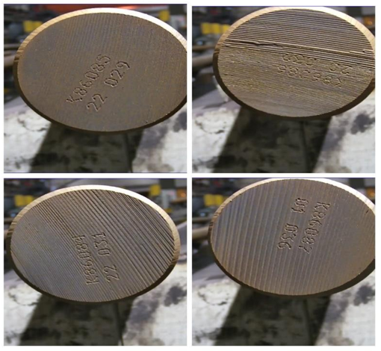
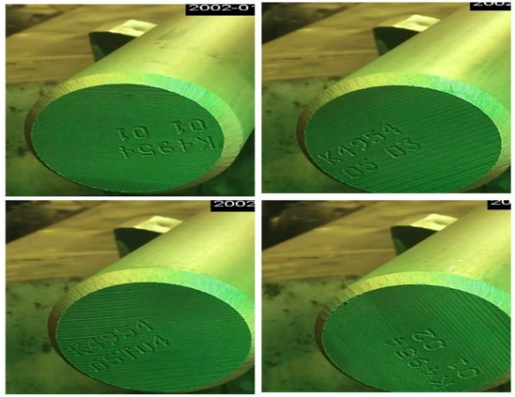
Old Images New Images

Slide 14
Applying existing OCR techniques on Old Images
Easy OCR
Easy OCR is directly installed into the code interface and old images are given as input to the EASY ocr which resulted 0% in identifying the character on the steel rod.
Tesseract OCR
The old images are given to tesseract OCR which resulted in 0% accuracy.
Hyper-parameter tunning is applied in altering the values of the parameters like
“-PSM” and “-OEM”.
PSM has 14 values which determines the how the script and page should be assumed. The –oem argument provides four values ranging from 0 to 3, corresponding to various OCR architectures
After using all different kinds of option it resulted in 0% accuracy in identifying charcters.

Slide 15
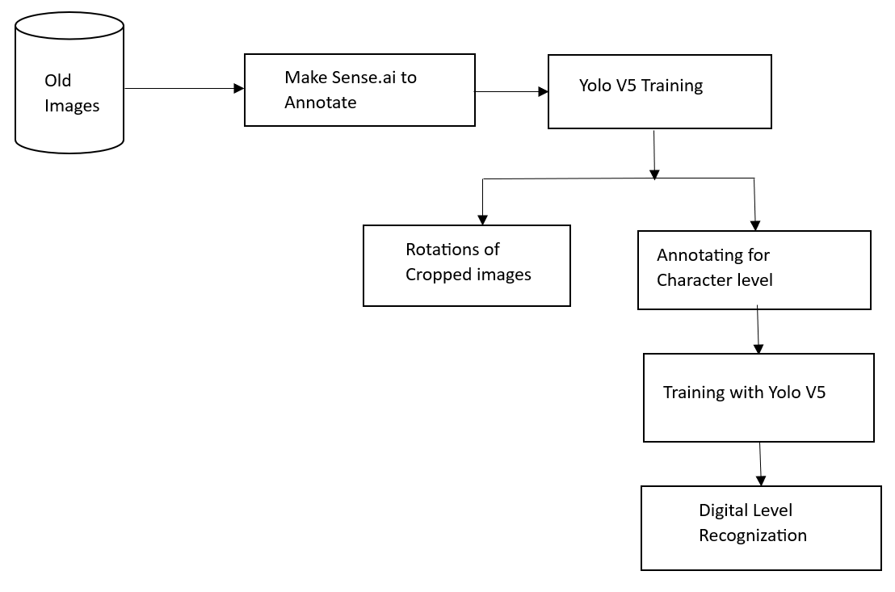
Old image
Methodology Used for Old Images

Slide 16
Rectangular bounding Boxes
1.The old images were manually annotated using makesense.ai annotating tool.
2.The images are annotated using rectangular annotations and then downloaded in yolov5 format.
3.Out of 1000 , only 850 images are annotated and remaining are left for testing. In those 850 images 700 are used for training and 150 for validation.

Slide 17
Training old images with YOLOv5
1.The images and annotated are given to the yolov5 for training.
2. Before training, an YAML file is created , which stores the path of the images and annotation , yolo uses this a the root file to locate the input .
3. yolov5 is directly cloned from the main GitHub repo. Some parameters like no.of epochs, images sizes values are changed to achieve good map.
4. While training the Yolo it creates 2 subfolders named train and detect , and stores the information related weights, graphic representations of object loss, box loss, precision, and recall for all epochs.
5. In detect folder it stores the results of the test data, like images and bounding boxes along with the annotations. (best weights from the training are used to test ).
6. Save crop and save txt option are used to extract the cropped images and the annotation files of the each image.

Slide 18
Rotational bounding boxes to correct orientation
Tesseract OCR
it has the ability to recognize orientation and rotate the image at the identified angle. It makes use of the "imutils.rotate_bound" option, which rotates the image at that angle. However, it fails to properly orient the bounding box
Hough Transform
The Hough Transform is utilized for line detection and orientation adjustment based on detected lines. Nevertheless, it struggles with accurately orienting bounding boxes, particularly when lines are parallel to the x and y axes.
OpenCV:
OpenCV calculates the minimal area rectangle and determines the angle for image rotation.
Despite its capabilities, none of these methods seem to effectively correct image orientation based on the text present on steel bars.

Slide 19
Character level recognization of YOLOv5
1.A different strategy is taken into consideration, such as training the yolov5 at the character level.
2. the dataset is manually annotated for each character on the steel bar. To annotate makesense.ai tool is used, where character level yolov5 has 13 classes and in each image, almost 10 classes need to be identified. In 1510 annotations were made for the 151 steel bar images, the data is divided in the 70:15:15 ratio of training, validation, and testing respectively.
3. While training the images , collision of bounding boxes is observed which leading to loss of information of characters. Even tough increasing of MAP is observed but there is character loss. This lead to new approach for the new images.

Slide 20
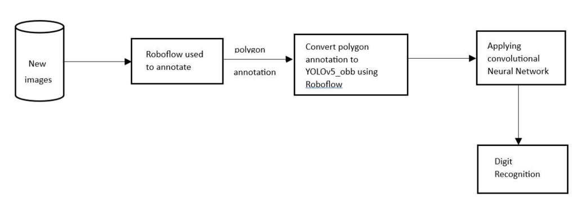
New Images
Methodology used for new images

Slide 21
Annotations for YOLOv5 _obb
1.The new images are annotated using polygon annotations and then converted to yolov5–obb format using Roboflow tool.
2. In total, 2,500 new images have been manually annotated for YOLOv5-obb using the Roboflow annotating tool. All 2500 images are under a single class. 2300 images are under training and 200 images are under validation.

Slide 22
Training of YOLOv5 _OBB
1. Image annotations in YOLOv5-obb are stored in the "labeltxt" folder.
2. A YAML file contains class information and image paths for training, validation, and testing.
3. YOLOv5-obb, an addon for YOLOv5, generates oriented bounding boxes based on rotation angles.
5. Hyperparameter tuning is performed to enhance model performance and reduce excessive bounding box detections.
6. The number of training images is incrementally increased from 200 to 2300 during the experiment.
7. Results, including mAP, best weights, and various performance metrics, are recorded and analyzed in subsequent chapters.
8. The "runs" folder stores training and detection results for each experiment.

Slide 23
Discussions
RQ1: How good is the proposed model at recognizing the characters on the Steel bars?
As stated in methodology at first old images are given to existing OCRS , but resulted In 0 accuracy.
Unlike traditional pictures like number plate or door number plates, the characters were printed into the surface of the steel, making detection more difficult.
This problem given a new path to the techniques , so considering the OCR problem as object detection problem.
Yolov5 is used and it needs labeled data , however, no pre-annotated dataset is adequate for this industrial data. As a result, the data is manually annotated using the Makesense.ai tool

Slide 24
With defaults parameters yolov5 resulted poor map so parameters are altered to improve.
S.no | Name | No. of. epochs | Training mAP
1 | Base line performance | 3 | 0.30
2 | Hyperparameter tunning | 50 | 0.56
3 | Hyperparameter tunning | 100 | 0.87
4 | Hyperparameter tunning | 150 | 0.995

Slide 25
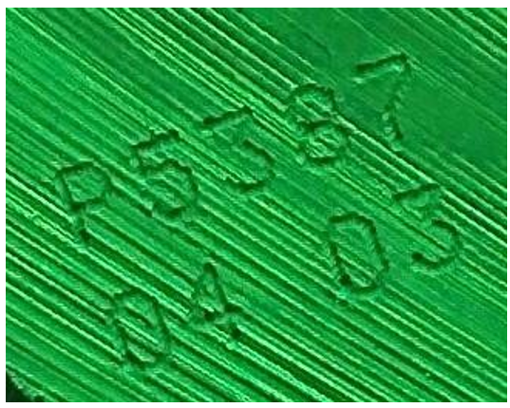
1.After using save crop option in yolov5 the cropped images is extracted.
2. When we observe the cropped image the text on the image is not in the proper orientation, so an attempt was made to rotate the images based on the text on it

Slide 26
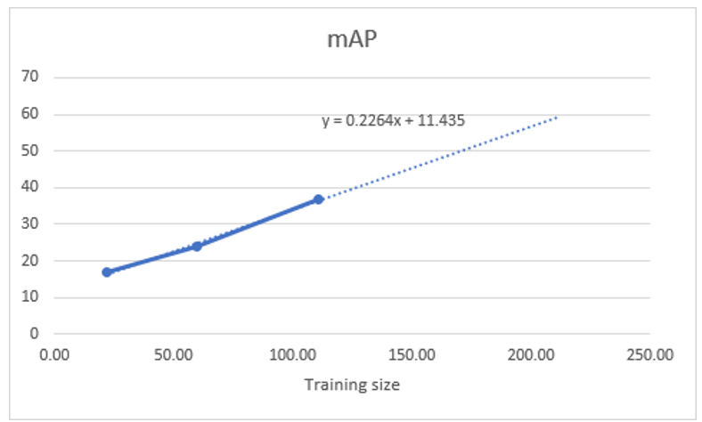
While using tesseract for rotation surprisingly it detected the on the cropped images as “Arabic” and rotated image with 180 degree, not only tesseract remaining Hough and OpenCV detection rotation angle as solid number which is poor in rotating
Yolov5 at character level is used where a gradually improvement of map is observed

Slide 27
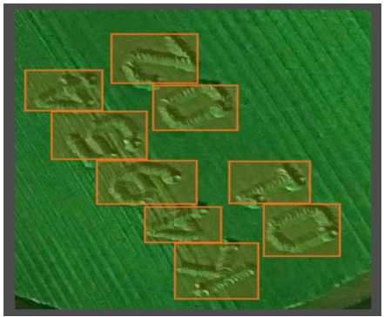
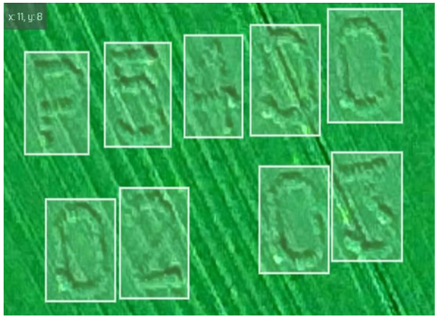
Even tough there is improvement of map, but a challenge is faced during the annotation due to non rotation of images in proper orientation.
Worst case
Best case

Slide 28
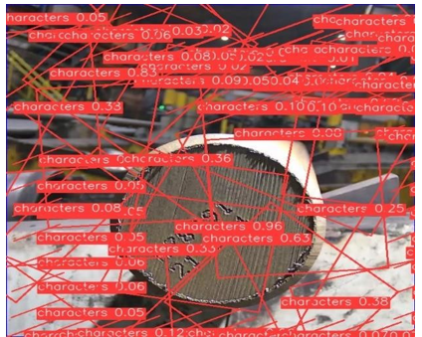
Yolov5 _obb is used to avoid the problems faced in character level yolov5 , but while training the yolov5 many issues are faced like.
More training time
2. More care is taken while using hyper parameter tunning to avoid many bounding boxes.

Slide 29
Large data needed to achieve good map.
Experiment number | Training data | mAP
1 | 200 | 0.479
2 | 300 | 0.42
3 | 400 | 0.548
4 | 500 | 0.544
5 | 600 | 0.599
6 | 700 | 0.72
7 | 800 | 0.66
8 | 900 | 0.74
9 | 1000 | 0.79
10 | 1400 | 0.82
11 | 1800 | 0.87
12 | 2300 | 0.93

Slide 30
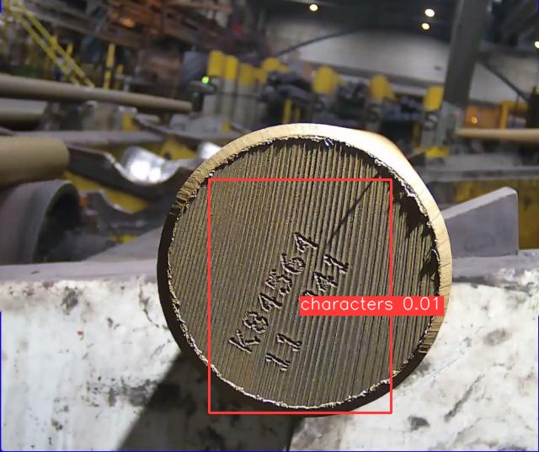
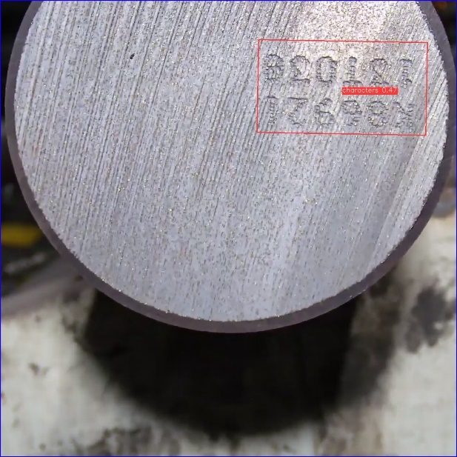
Experiment -5 Experiment -12

Slide 31
RQ2 What are the uncertainty conditions in the images that must be overcome to make better predictions?
Camera Focus and Positioning: Special attention is needed in camera placement and focus when photographing steel bars. Fluctuations in camera focus can result in blurry and defocused images, affecting the quality of data.
Needle Care: Careful handling of the needle used to print characters on steel bars is essential. Over time, the needle can lose its sharpness, leading to missing characters in images. Regular maintenance and replacement of the needle are recommended.
Adjusting Lighting: Shifting the positions of the lighting that reflects on the steel bars during photography can improve image quality. Variations in light focus can impact the system's ability to process the images effectively.
Image Consistency: Ensuring consistent image conditions, including focus, lighting, and character printing, is crucial for obtaining reliable results in the research.

Slide 32
Results
Existing pre-trained OCR models
Model Name | Version used | Character recognization Accuracy
Tesseract OCR | 5.0 | 0
Easy OCR | 1.6.2 | 0
Google lens | 1.14.2203230 | 0

Slide 33
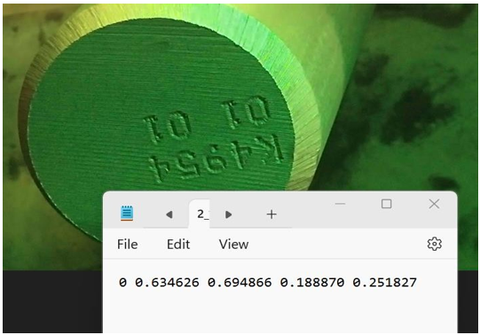
Yolov5 Manual annotations
1. Each image will have one text file which contains the details like class name , and dimensions

Slide 34
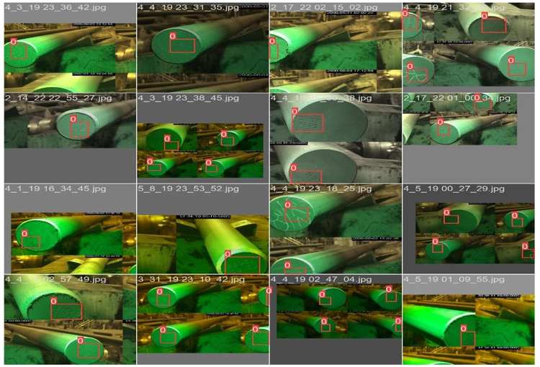
Train Image
The training phase produced an outstanding model performance, with a mean average precision (mAP) score of 0.99

Slide 35
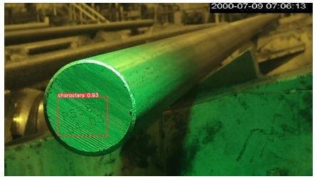
Test Images
The test data using the model weights that had been learned with a remarkable 0.99 mAP on the training data.
The test data that detected the ROI with 0.95 mAP.

Slide 36
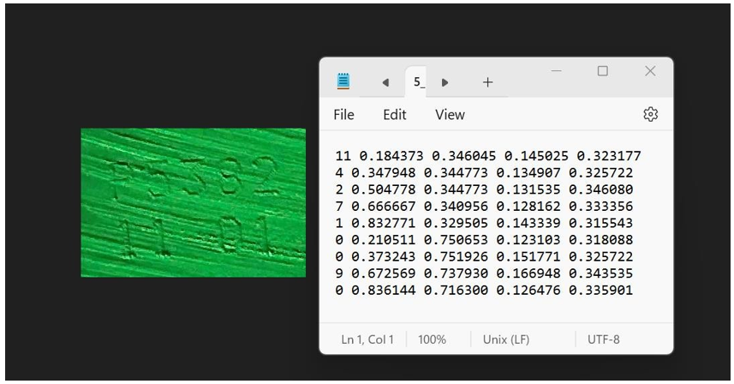
Yolov5 at character level

Slide 37
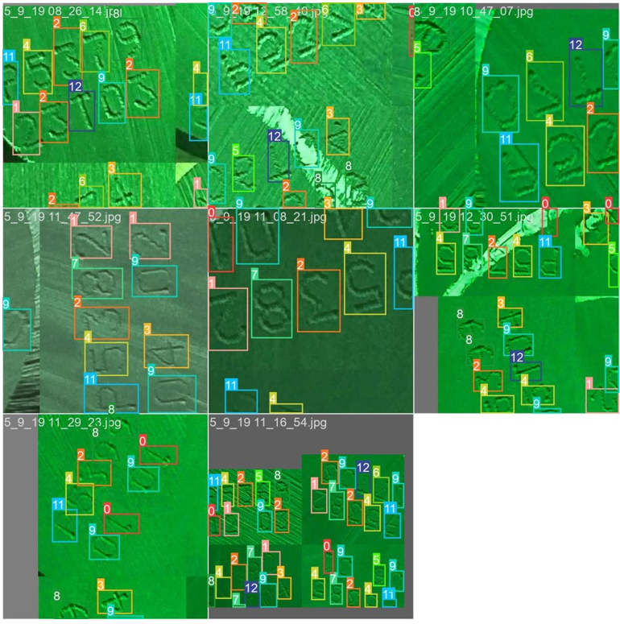
Train Image
The model was trained on a dataset of 130 manually annotated photos and yielded a mAP of 0.54

Slide 38
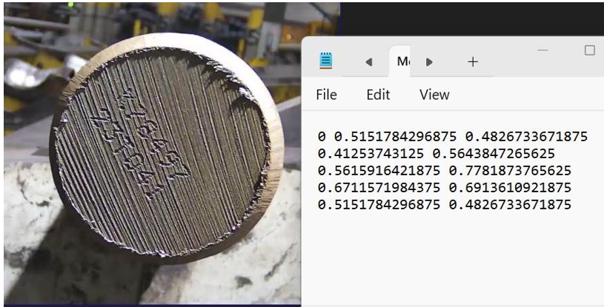
Yolov5-Obb manual annotations

Slide 39
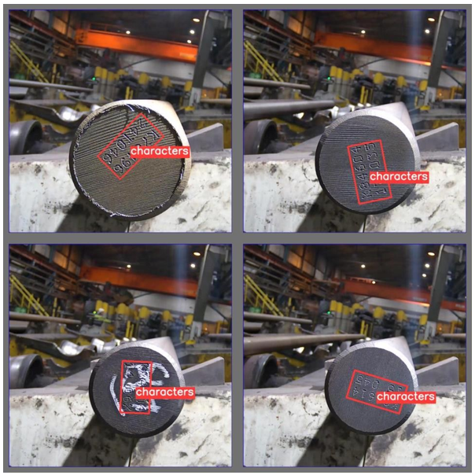
Train Image:
The training picture of yolov5-obb with 2300 images and achieved a 0.93 mAP. The ROI is properly identified and there is a proper orientation in the bounding box.

Slide 40
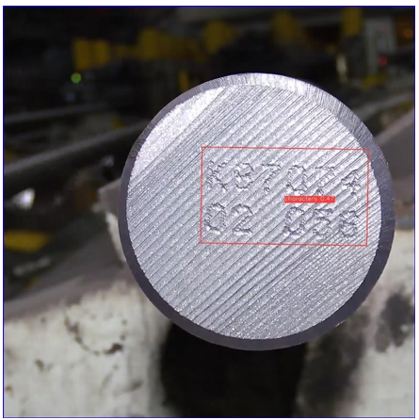
Test image:
Test image that is obtained by using the best weights of the YOLOV5-obb.

Slide 41
Comparison of results
SNO | Model | mAP
1 | ROI:SSD MobileNet V2 FPNLite 320x320 [26] | 90.4
2 | Yolov5(proposed model) | 95.0

Slide 42
Conclusion
1. The focus of this thesis is to build an OCR system for accurately recognizing characters on steel bar images at OVAKO, using YOLOv5 and pre-processing techniques.
2. The YOLOv5 model achieved a 0.99 mAP in detecting bounding boxes, but faced challenges in orientation correction and character recognition accuracy.
3. To address these issues, a new technique called YOLOV5_obb was experimented, achieving a 0.93 mAP in detecting oriented bounding boxes.
4. The resulting cropped images were not yet subjected to character identification using a convolutional neural network, which is considered future work.
5. The developed technique showed promise in solving orientation problems, but limitations remain in manual annotation, orientation correction, and character recognition accuracy.
6. Further research is needed to explore more efficient and effective OCR techniques for steel bar images.

Slide 43
Future work
Training the YOLOV5-obb with some more data to increase the test data mAP, so that exact oriented bounding boxes can be seen for the test data.
As mentioned in the conclusion the cropped images from the YOLOv5-obb and then they are sub jected to a convolution neural network to get the accurate character.
Some improvements in the image quality like lighting on the image, and the position of the camera, the distance between the camera and the steel bar, will definitely have an impact on the performance

Slide 44
Any questions

Slide 45
Thank You

